Slide 1
Study Material of Sem-III Chemistry Hons.
Inorganic Chemistry-II
Molecular Orbital Theory
Prepared By
Dr. Amit Mondal
B.K.C. College, Chemistry Department.

Slide 2
What is Molecular Orbital Theory?
Molecular Orbital theory is a chemical bonding theory that states that individual atoms combine together to form molecular orbitals. Due to this arrangement in MO Theory, electrons associated with different nuclei can be found in different atomic orbitals.
In molecular orbital theory, the electrons present in a molecule are not assigned to individual chemical bonds between the atoms. Rather, they are treated as moving under the influence of the atomic nuclei in the entire molecule.

Slide 3
Postulates of Molecular Orbital Theory
The total number of molecular orbitals formed is equal to the total number of atomic orbitals offered by atomic species.
The electrons in the molecular orbital are filled in the increasing order of orbital energy (from orbital having lower energy to orbital having higher energy).
Orbital with lower energy followed by higher orbital energy is the pattern of electron alignment.
Molecular Orbital Theory or MOT Theory describes three types of orbital based on the pattern of electron bonding. These are –
Bonding molecular orbital
Non-bonding molecular orbital
Anti-bonding molecular orbital
Out of these, antibonding molecular orbitals always have high energy than the parent orbitals.
However, molecular orbitals always have lower energy than parent orbitals.
Each atom combines to form a molecular orbital and electrons are found in atomic orbitals bonded to different nuclei.
The most effective combinations of atomic orbitals occur when the combining orbitals have the same energies.
Electrons are located anywhere within the molecule.

Slide 4
Linear Combination of Atomic Orbitals (LCAO) of MO Theory
The molecular orbitals in MO Theory are expressed through a Linear Combination of Atomic Orbitals (LCAO). These LCAOs are useful to estimate the formation of these orbitals in the bonding between the atoms that form a molecule.
The Schrodinger equation that is used to describe the behavior of electrons for the molecular orbitals can be written in a method as the atomic orbitals.
It is an approximate method that is used to represent molecular orbitals.
It is a superimposition method where constructive interference of 2 atomic wave functions results in the production of a bonding molecular orbital whereas destructive interference produces a non-bonding molecular orbital.

Slide 5
Conditions for Linear Combination of Atomic Orbitals
Same Energy of combining orbitals – The combining atomic orbitals must have the same or approximately the same energy. This means that the 2p orbital of an atom can combine with another 2p orbital of another atom but 1s and 2p cannot combine as they have energy differences.
Same symmetry about the molecular axis – The combining atoms should have the same symmetry around the molecular axis for proper combination. For e.g. all the sub-orbitals of 2p have the same energy but still, the 2pz orbital of an atom can only combine with a 2pz orbital of another atom. It cannot combine with 2px and 2py orbital because they have a different axis of symmetry.
Proper overlapping between the atomic orbitals – The two atomic orbitals will combine to form a molecular orbital only if the overlap is proper. The greater the extent of overlap of orbitals, the greater will be the nuclear density between the nuclei of the two atoms.

Slide 6
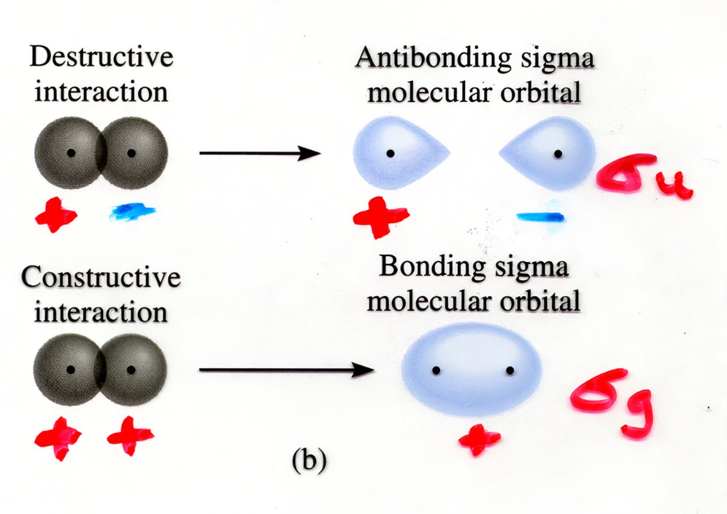
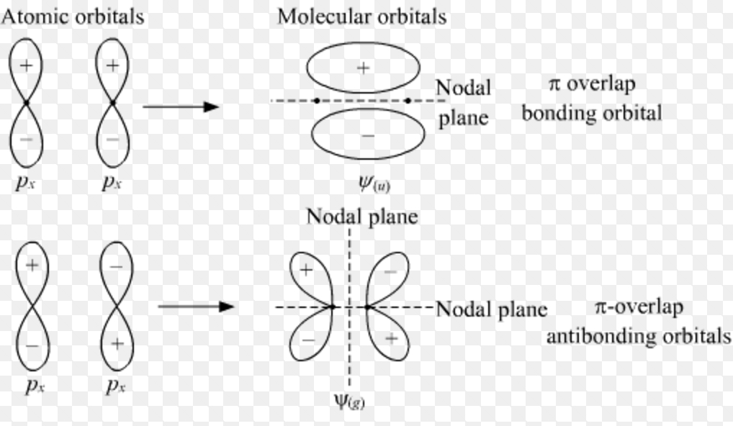
Symmetry: Molecular Orbitals
Symmetry will allow us to treat more complex molecules by helping us to determine which AOs combine to make MOs
Grade and ungerade for Sigma and pi-bond.

Slide 7
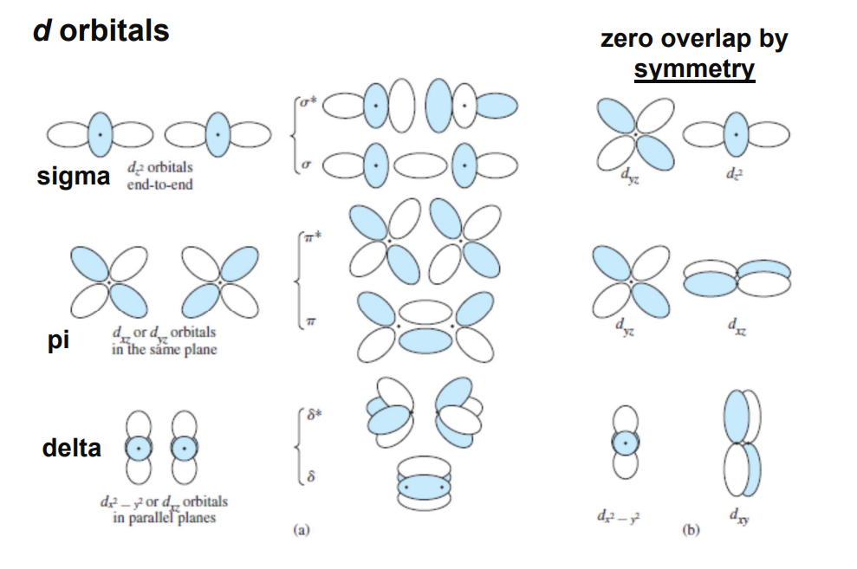
Symmetry: d- Orbitals

Slide 8
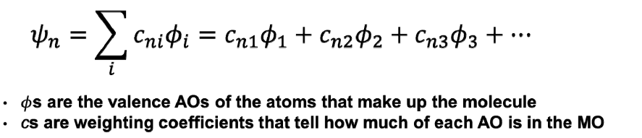
LCAO Rule: Mathematical treatment FOR DIATOMIC MOLECULE
The most common approximation of Molecular Orbital Theory is Linear Combination of Atomic Orbitals Methods

Slide 9
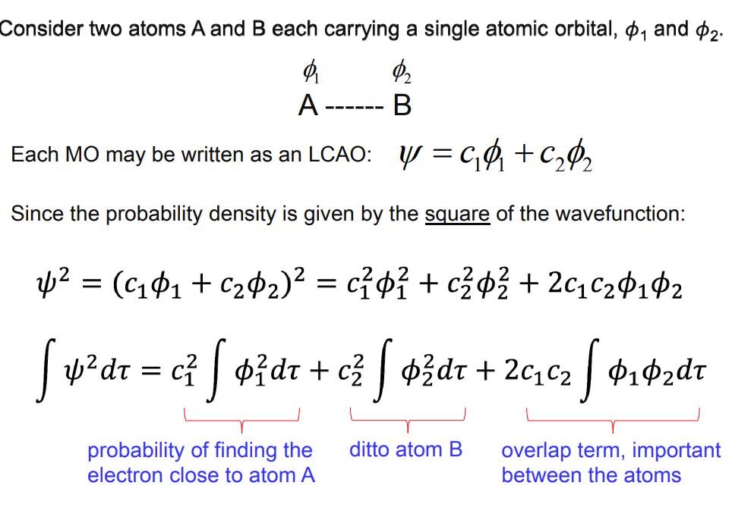
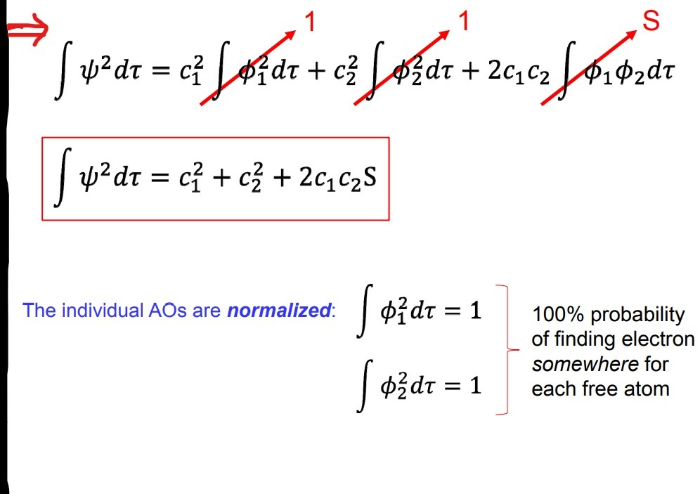
LCAO Rule: Mathematical treatment FOR DIATOMIC MOLECULE

Slide 10
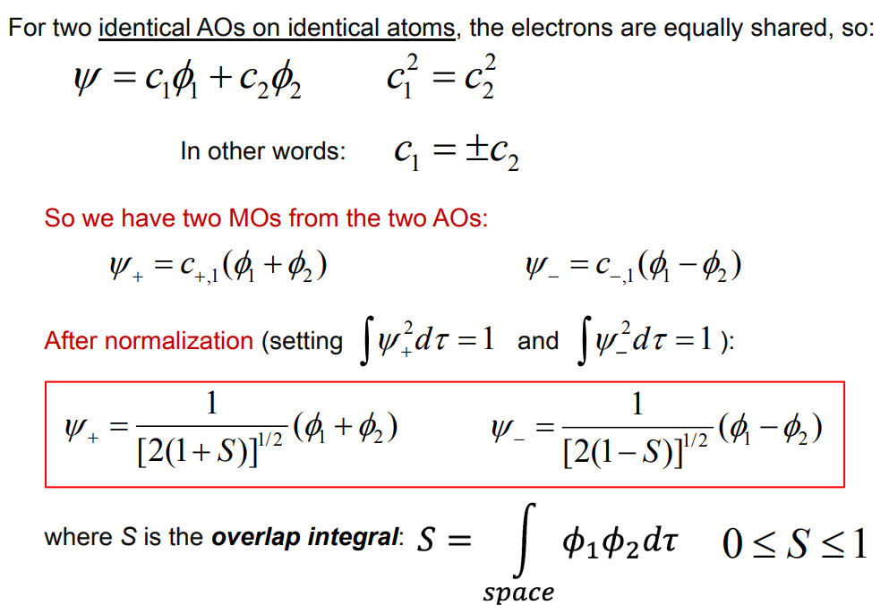
LCAO Rule: Mathematical treatment FOR HOMONUCLEAR DIATOMIC MOLECULE

Slide 11
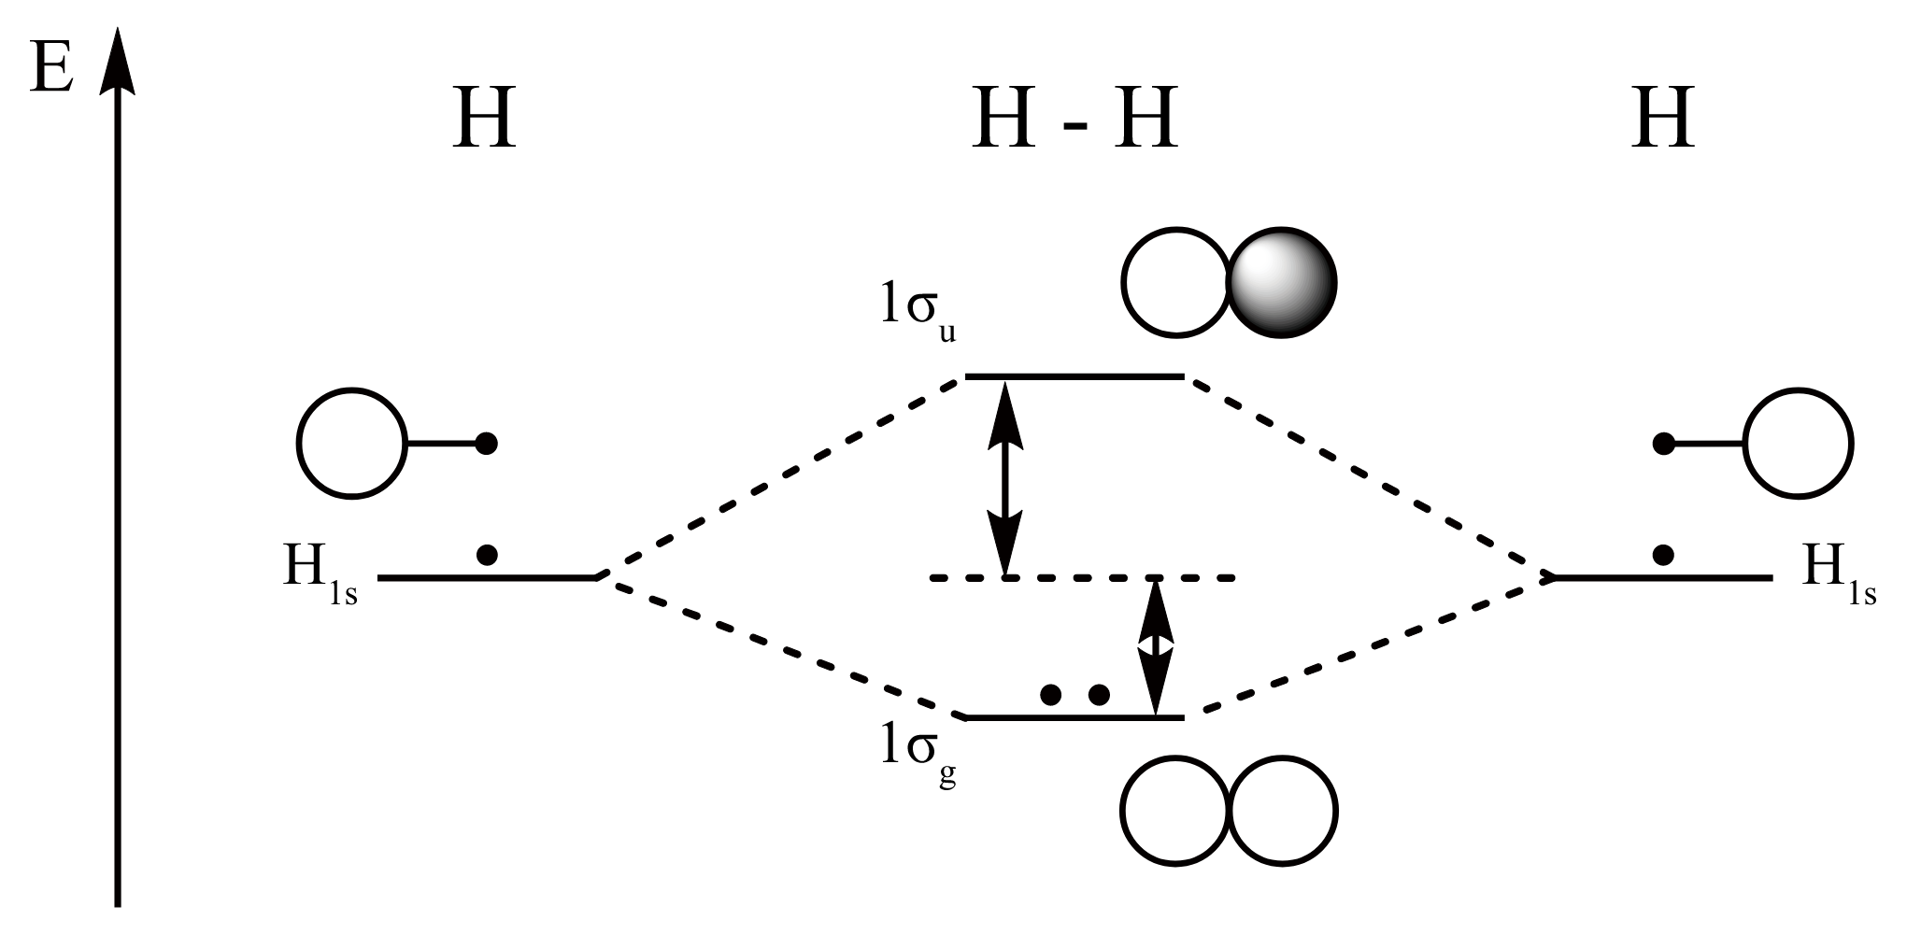
MO of H₂ molecule
In H₂ MO diagram both 1s orbitals of hydrogen atoms have identical in energy and they are place in a same energy level.
Bond Order i.e.,
B.O.= ½(Bonding electrons- Anti Bonding electrons)=1/2 (2-0) = 1

Slide 12
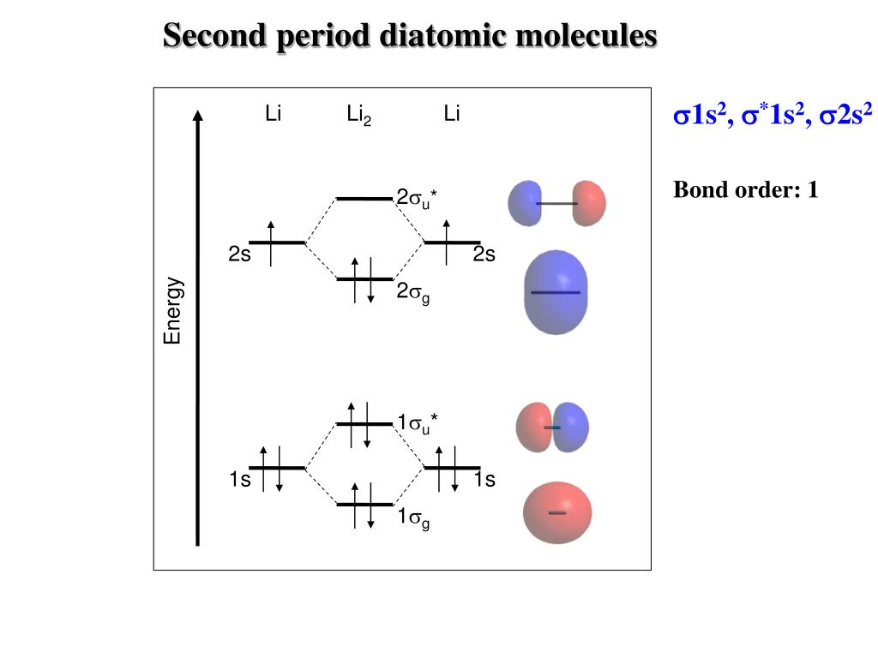
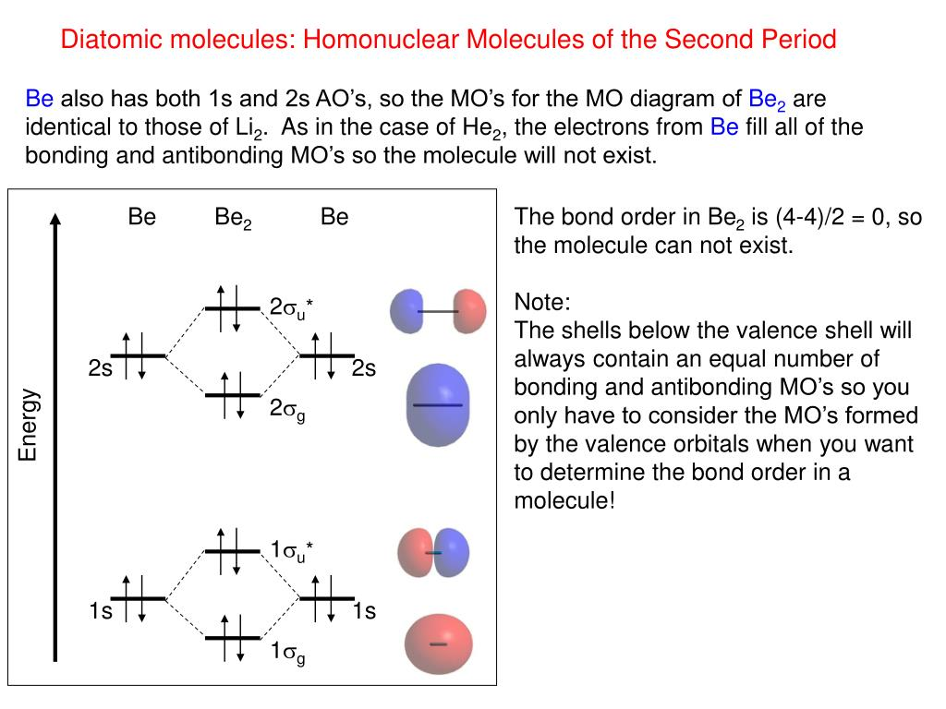
MO of li₂ & bE₂ molecules

Slide 13
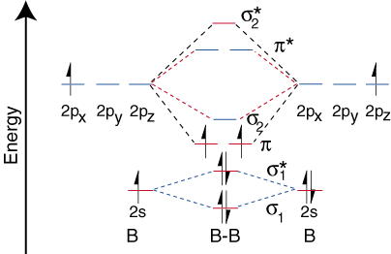
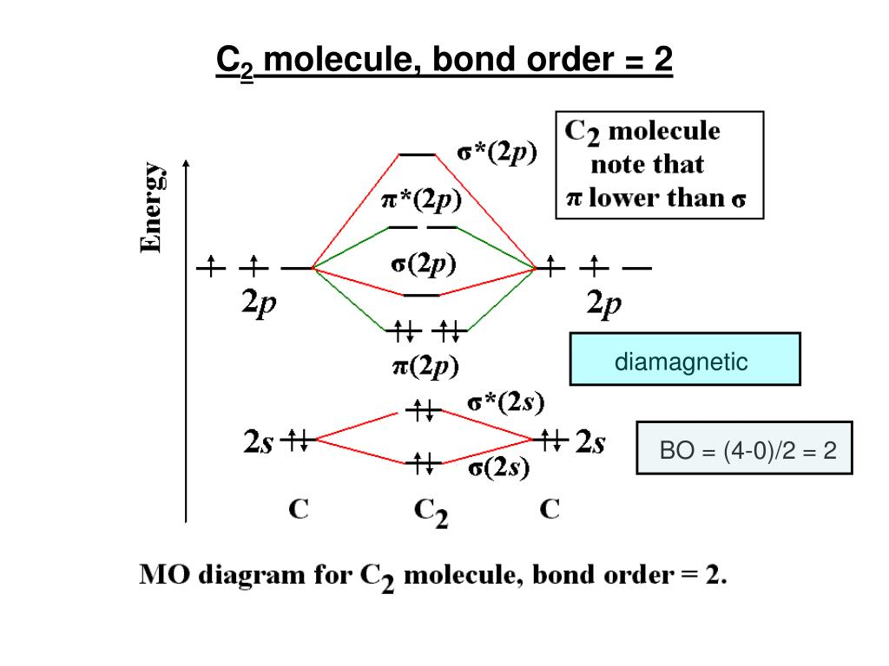
MO of B₂ & C₂ molecules
B.O. = ½(4-2) =1
σ₂ bonding is higher in energy than π bonding of less electronegative elements MOs i.e., from boron to nitrogen, due to σ-σ interaction (less energy gap between 2s and 2p orbital).

Slide 14
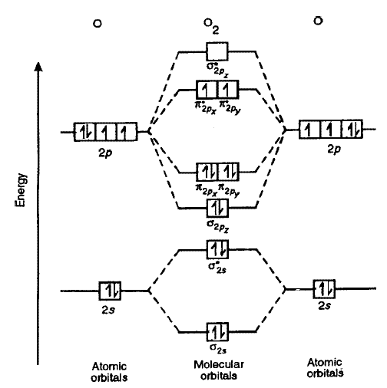
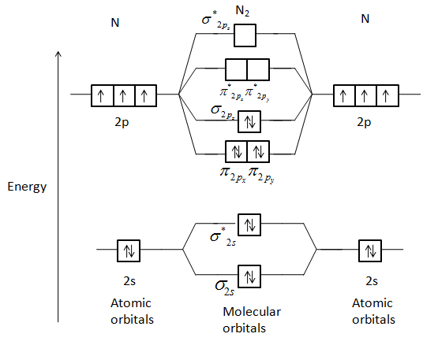
MO of N₂ & O₂ molecules
N₂ = σ_{g(1s)}² σ*_{u(1s)}² σ_{g(2s)}² σ*_{u(2s)}² π_{u(2p)}⁴ σ_{g(2p)}²
B.O. = ½ (8- 2) = 3
O₂ = σ_{g(1s)}² σ*_{u(1s)}² σ_{g(2s)}² σ*_{u(2s)}² σ_{g(2p)}²π_{u(2p)}⁴π*_{g(2p)}²
B.O. = ½ (8- 4) = 2

Slide 15
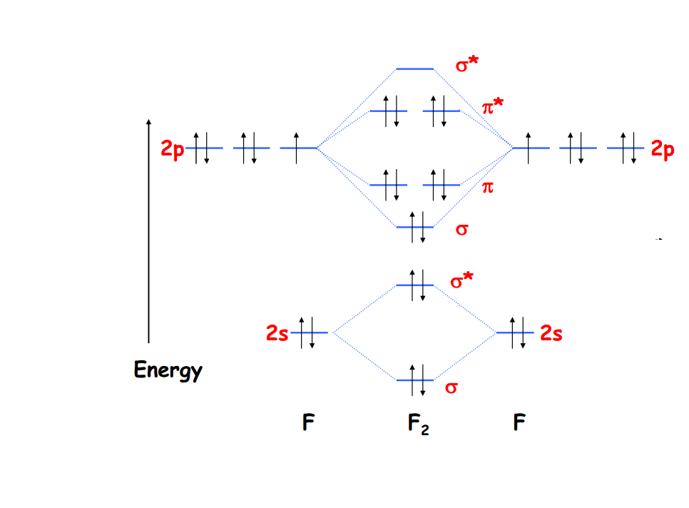
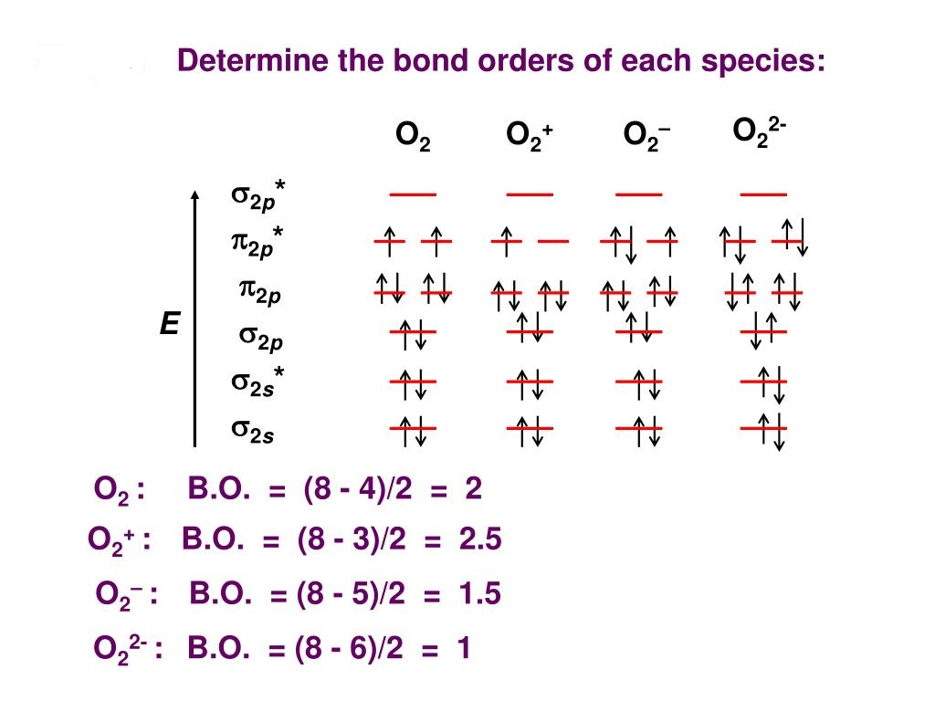
MO of F₂ & O₂ molecules
O₂ : Paramagnetic
O₂⁺ : Paramagnetic
O₂⁻ : Paramagnetic
O₂²⁻: Diamagnetic
F₂ = σ_{g(1s)}² σ*_{u(1s)}² σ_{g(2s)}² σ*_{u(2s)}² σ_{g(2p)}²π_{u(2p)}⁴π*_{g(2p)}⁴
B.O. = ½ (8- 6) = 1
F₂ molecule is diamagnetic.

Slide 16
MO of Heteronuclear Molecules
In heteronuclear diatomic molecules, mixing of atomic orbitals only occurs when the electronegativity values are similar.
In carbon monoxide the oxygen 2s orbital is much lower in energy than the carbon 2s orbital and therefore the degree of mixing is low.
The g and u subscripts no longer apply because the molecule lacks a center of symmetry.
The atomic orbital which is lower in energy is participated more (large coefficient) in bonding MO than higher energy atomic orbital and bonding electrons are placed more closed to the lower energy atomic orbital.
The atomic orbital does not find any similar or comparable energy orbital for bonding, participated in MO as a non-bonding orbital.

Slide 17
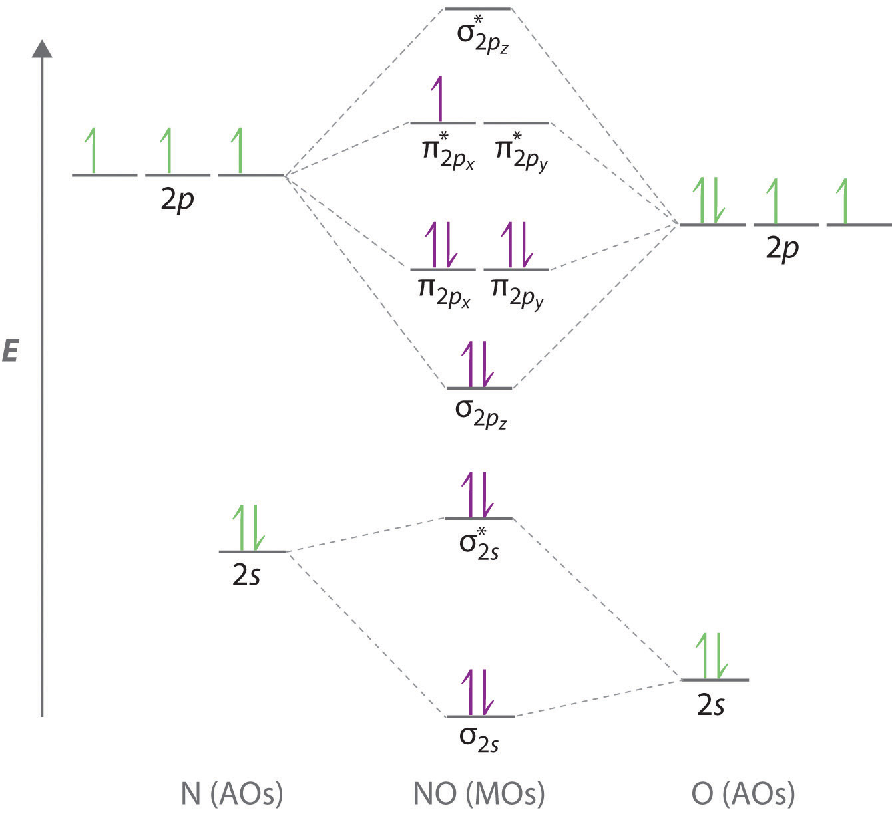
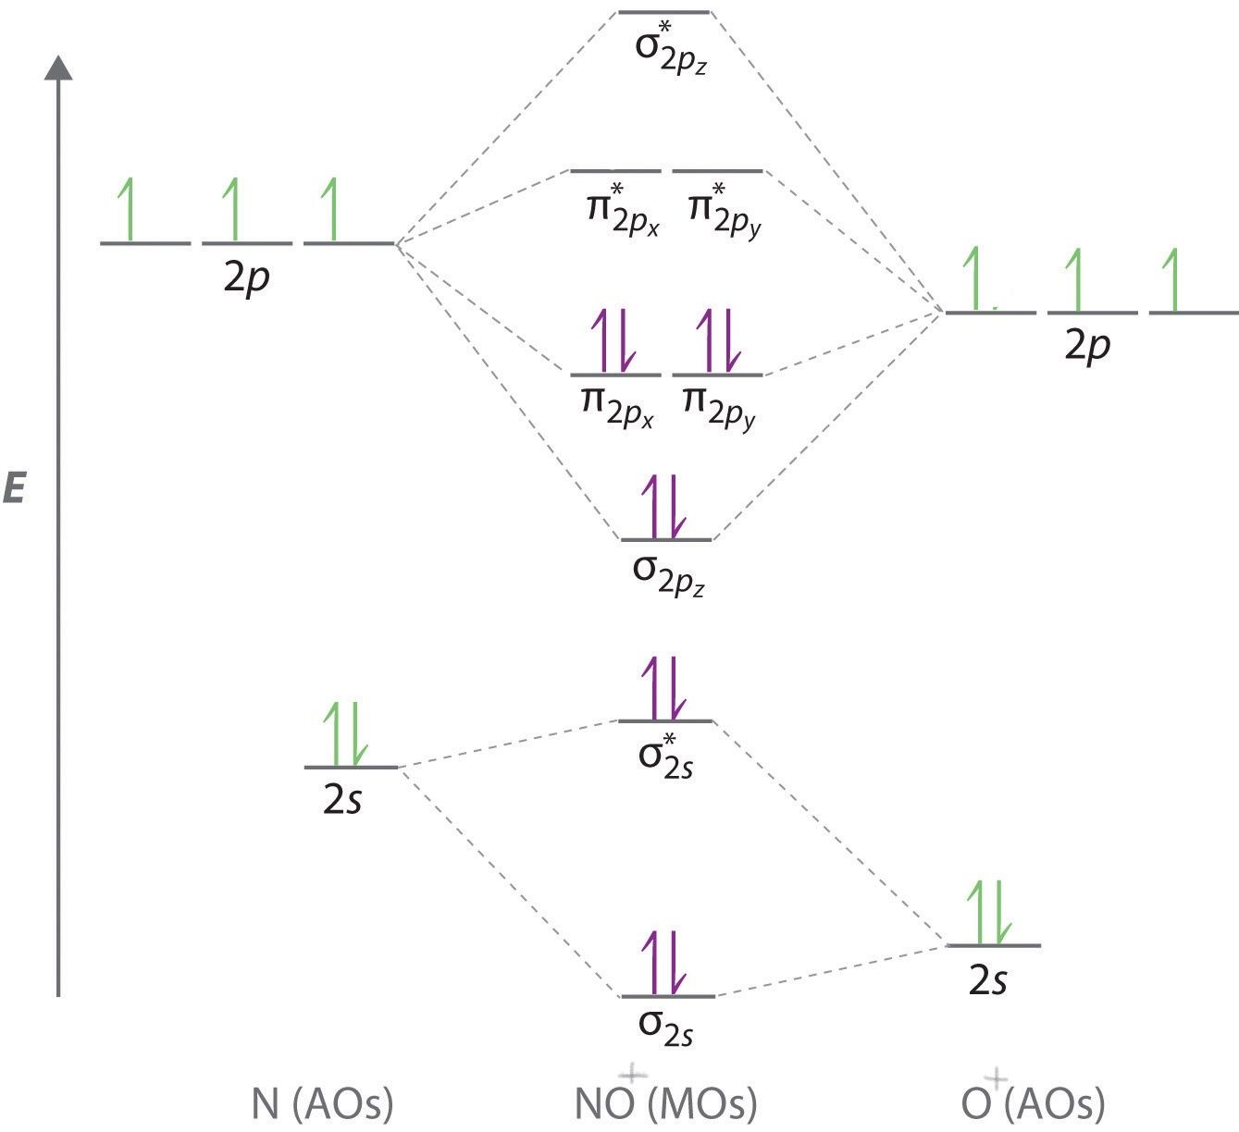
MO of NO & NO⁺ molecules
B.O. = ½ (8- 3) = 2.5
B.O. = ½ (8- 2) = 3

Slide 18
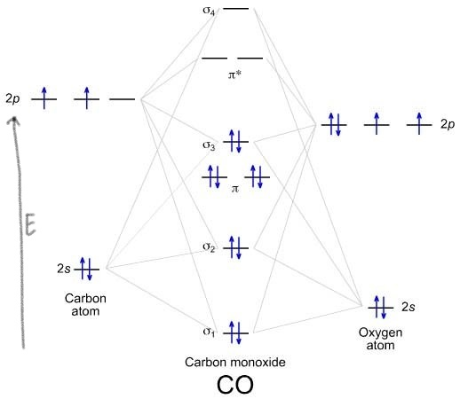
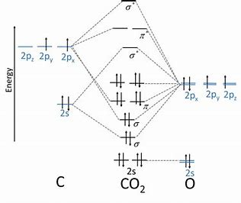
MO of CO & CO₂ molecules
B.O. = ½ (8 - 2) = 3
B.O. = ½ (8- 0) = 4

Slide 19
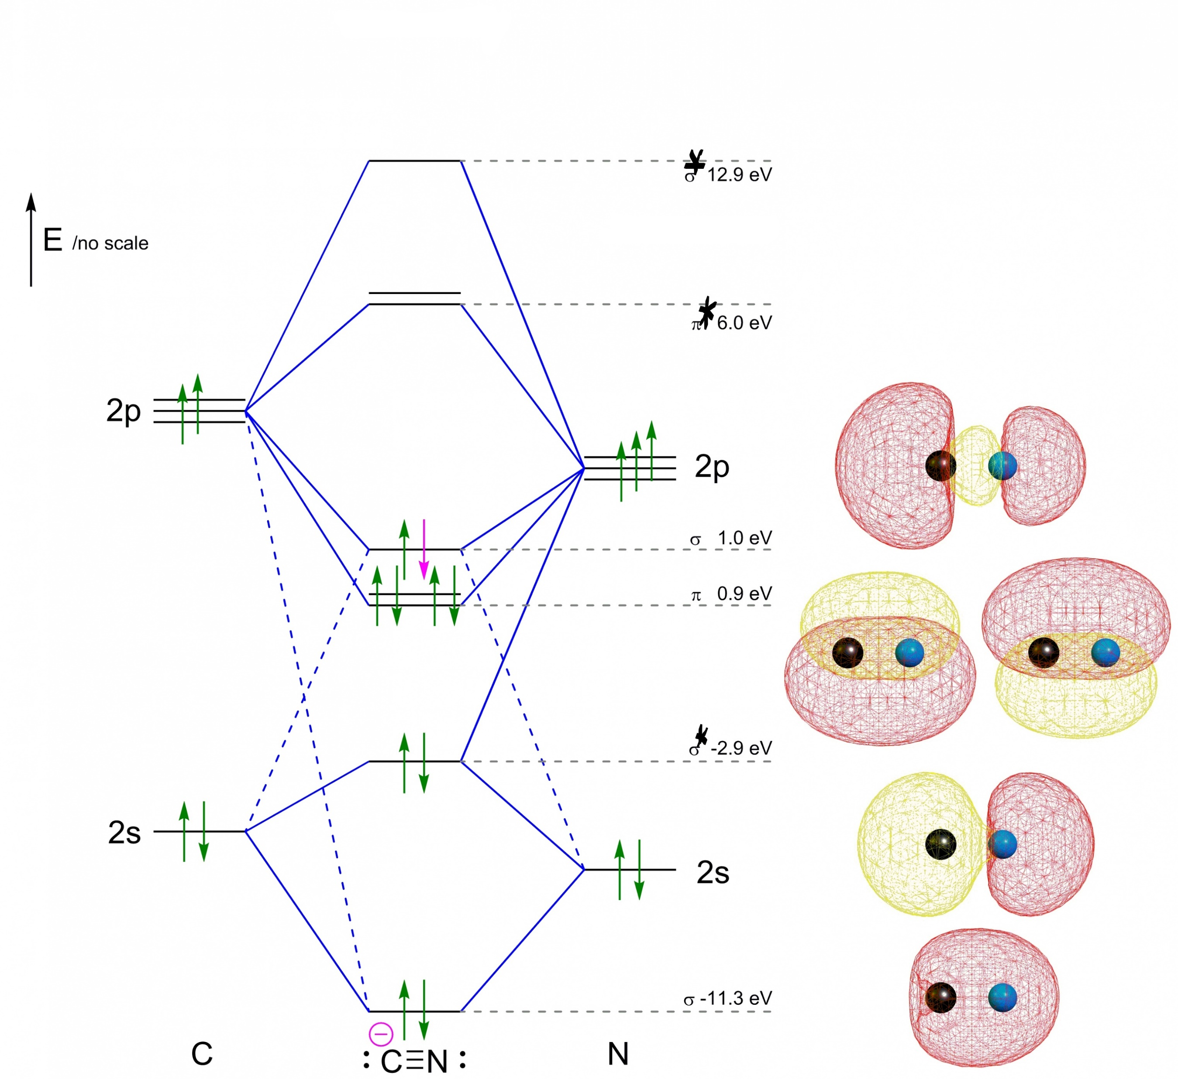
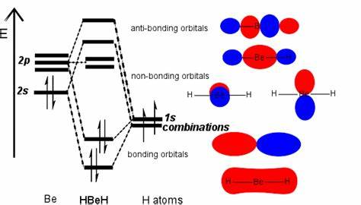
MO of CN⁻ & BEH₂ molecules

Slide 20
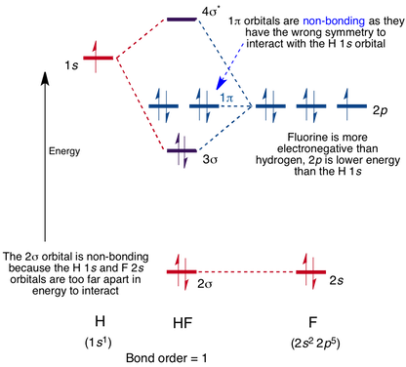
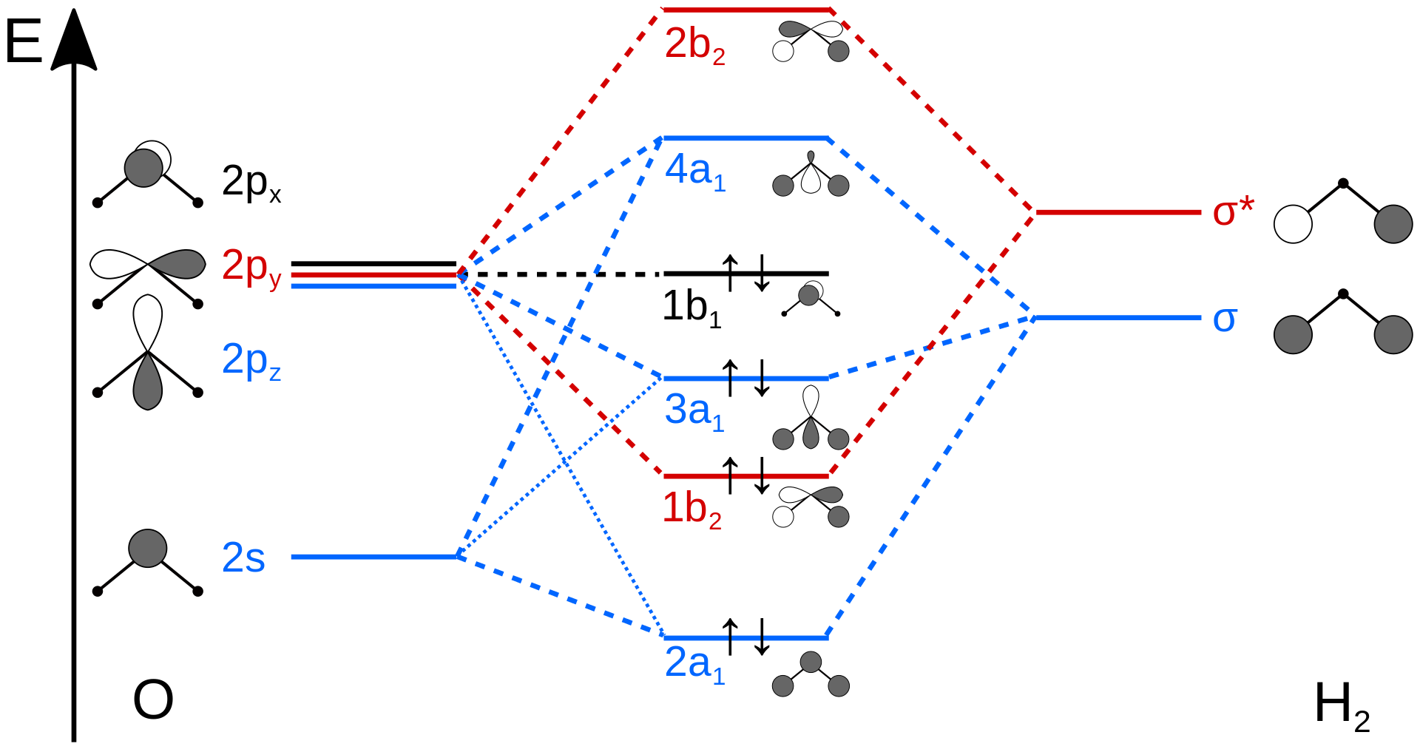
MO of HF & H₂O molecules
H₂O

Slide 21
Questions
Mention the conditions for linear combination of atomic orbital related to the formation of molecular orbital.
Construct the MO energy level diagram of CO₂ molecule showing the arrangement of electrons. Find out the number of bonding and non-bonding electrons.
Arrange with reason, the stability order of the following species: NO, NO⁺ and NO–
Compare the bond lengths of O₂ ⁺ and N₂ ⁺ .
Draw M.O. diagram of CN¯ and predict the bond order as well as magnetic properties.
Give molecular orbital configuration of O₂, O₂⁺ and O₂⁻ . Give order of stability with appropriate reasons.
Using molecular orbital configurations indicate paramagnetic nature of B₂ and non-existence of Ne₂.
Draw MO diagram for NO molecule. Compare the bond dissociation energies of NO+ and NO– species and explain the difference.
From the view point of MO theory, explain why BeH2 is a linear molecule.
Construct the MO diagram for H2O. Calculate the bond order from it.
Explain why the O-O bond length varies as O₂⁺˂ O₂ ˂ O₂⁻
Compare the bond lengths of O₂⁺ and N₂⁺.
Draw the approximate energy level diagram of HF molecule. Discuss the polarity of the HF molecule from the diagram.

